Slide 1

CS144 An Introduction to Computer Networks
Packet Switching
Queue models
Nick McKeown
Professor of Electrical Engineering
and Computer Science, Stanford University

Slide 2
Outline
Simple deterministic queue model
Small packets reduce end to end delay
Statistical multiplexing

Slide 3
Simple model of a router queue
HIDE
Router queue
A(t), λ
D(t)
R
Q(t)
Properties of A(t), D(t):
A(t), D(t) are non-decreasing
A(t) >= D(t)
Notes:
DRAW the next 3 slides to explain simple model of a router queue to simple deterministic model of a queue (3,4,5).

Slide 4
Simple model of a router queue
Notes:
DRAW the next 3 slides to explain simple model of a router queue to simple deterministic model of a queue (3,4,5).

Slide 5
Simple model of a queue
HIDE
Cumulative number of bytes arrived up until time t.
A(t)
A(t)
D(t)
Cumulative
number of bytes
Q(t)
R
R
Link
rate
time
D(t)
Properties of A(t), D(t):
A(t), D(t) are non-decreasing
A(t) >= D(t)
Cumulative number of bytes departed up until time t.

Slide 6
Simple model of a queue
Cumulative number of bytes arrived up until time t.
A(t)
Q(t)
R
Link
rate
D(t)
Cumulative number of bytes departed up until time t.

Slide 7
Simple model of a queue
HIDE
A(t)
D(t)
Cumulative
number of bytes
d(t)
Q(t)
Time
Queue occupancy: Q(t) = A(t) - D(t).
Queueing delay, d(t), is the time spent in the queue by a byte that arrived at time t, assuming the queue is served first-come-first-served (FCFS).

Slide 8
Simple model of a queue

Slide 9
Example
Cumulative
number of bits
Every second, a 100 bit packet arrives to a queue at rate 1000b/s. The maximum departure rate is 500b/s. What is the average occupancy of the queue?
A(t)
100
D(t)
0.1s
0.2s
1.0s
time
Solution: During each repeating 1s cycle, the queue fills at rate 500b/s for 0.1s, then drains at rate 500b/s for 0.1s. Over the first 0.2s, the average queue occupancy is therefore bits.
The queue is empty for 0.8s every cycle, and so average queue occupancy:

Slide 10
Outline
Simple deterministic queue model
Small packets reduce end to end delay
Statistical multiplexing

Slide 11

Packet Switching Why not send the entire message in one packet?
M/r₁
p/r₁
A
R1
R1
R2
R2
B
R3
R3
Breaking message into packets allows parallel transmission across all links, reducing end to end latency.

Slide 12
Outline
Simple deterministic queue model
Small packets reduce end to end delay
Statistical multiplexing

Slide 13
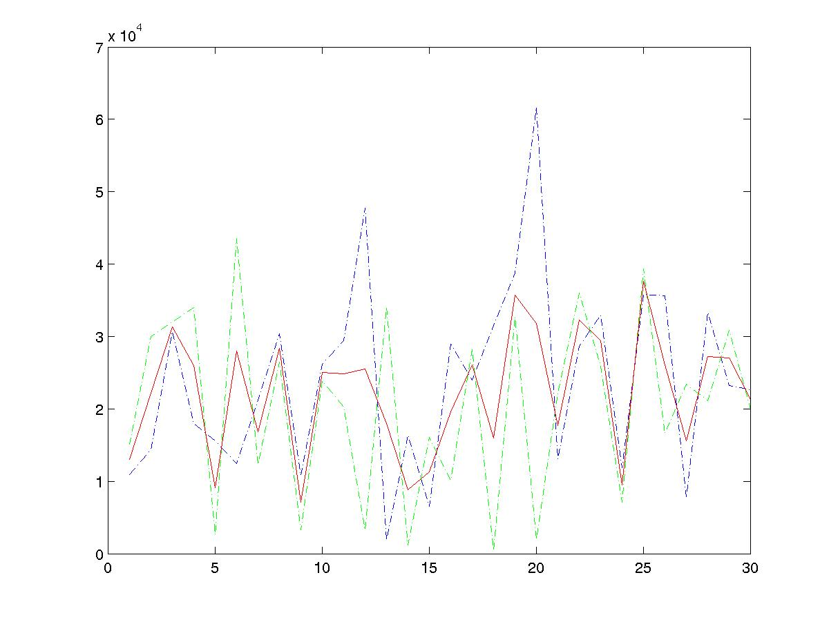
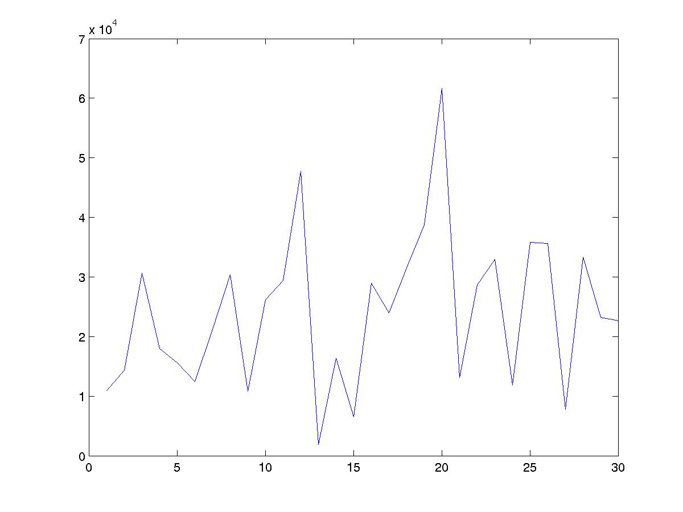
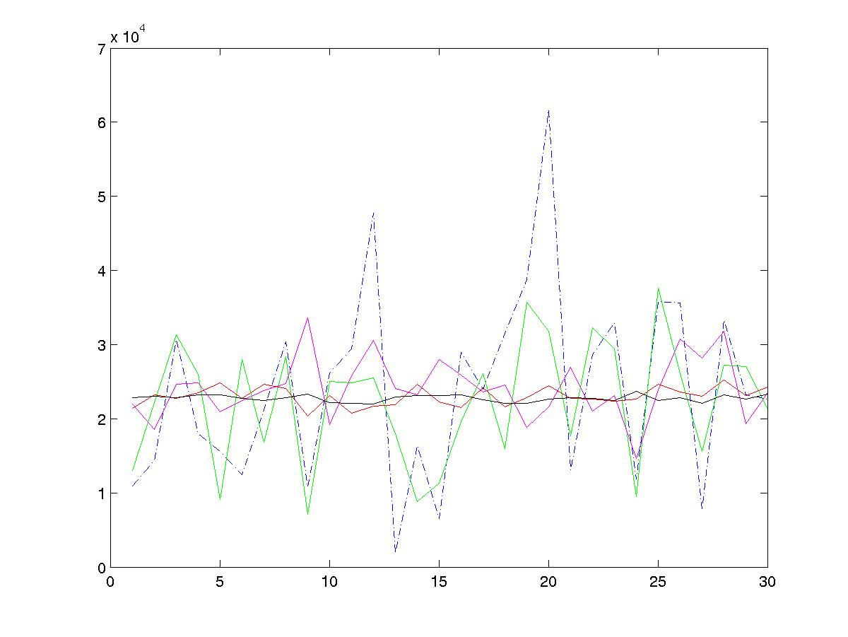
Statistical Multiplexing Basic idea
Two flows
Average rate
rate
One flow
rate
time
Many flows
rate
Average rates of: 1, 2, 10, 100, 1000 flows.
time
time
Notes:
Real traffic is not usually DETERMINISTIC --- packets show up at random times.
Network traffic is bursty. i.e. the rate changes frequently.
Peaks from independent flows generally occur at different times.
Conclusion: The more flows we have, the smoother the traffic.
This is what is known as STATISTICAL MULTIPLEXING, and is one of the main reasons packet switching is used.
The basic idea is that the link capacity we need to carry N flows, is much less than N times the capacity we need to carry 1 flow.

Slide 14
Packet Switching Statistical Multiplexing
HIDE
Packets for one output
Queue Length
X(t)
1
Data
Hdr
R
X(t)
2
Data
Hdr
R
Link rate, R
R
Packet buffer
N
Data
Hdr
Time
Because the buffer absorbs temporary bursts, the egress link need not operate at rate N.R.
But the buffer has finite size, B, so losses will occur.

Slide 15
Packet Switching Statistical Multiplexing
Packets for one output
1
Data
Hdr
R
Q(t)
2
Data
Hdr
R
Link rate, R
R
Packet buffer
N
Data
Hdr
Statistical multiplexing means the egress link need not run at rate NR.
The buffer absorbs brief periods when the aggregate rate exceeds R.
Because the buffer has finite size losses can occur.
Notes:
DRAW in the graph from the previous slide showing X(t) [queue occupancy] growing.
DRAW the value of B, to show that packets will be dropped when X(t) reaches B.

Slide 16
Statistical Multiplexing
Rate
A
C
A
C
time
Rate
B
C
B
C
time
Notes:
Statistical multiplexing
Important if traffic is bursty
Less expensive
Contention requires buffering
Variable delay => no QoS guarantees

Slide 17
Statistical Multiplexing Gain
A+B
Rate
2C
R < 2C
A
R
B
time
Statistical multiplexing gain = 2C/R
Notes:
Statistical multiplexing
Important if traffic is bursty
Alternative definition: For a given buffer size, the ratio of the rates needed to prevent packet loss. The bigger the buffer, the bigger a temporary surge can be accommodated, and hence the bigger the statistical multiplexing gain.

Slide 18
Summary
Often, we can use a simple deterministic model of a queue to understand the packet dynamics in a network.
We break messages into packets because it lets us pipeline the transfer, and reduce end to end delay.
Statistical multiplexing lets us carry many flows efficiently on a single link.

Slide 19
<end>

